Slide 1
《计算与软件工程II 》
Ch14 “面向对象”的模块化
丁二玉
南京大学软件学院

Slide 2
Module
A piece of code
  Methods
  Class
  Module(package)
Coupling: among pieces
Cohesion: internal a piece

Slide 3
What’s the difference between Structural methods and OO methods
Coupling
  Coupling is the measure of the strength of association established by a connection from one module to another
Structural methods
    A connection is a reference to some label or address defined elsewhere
OO methods
  Interaction coupling
  Component coupling
  Inheritance coupling

Slide 4
Main Contents
Coupling of OO
  Interaction Coupling
  Component Coupling
  Inherit Coupling
  Coupling Metric of OO
Cohesion of OO

Slide 5
Single interaction coupling
Method Invoke or Attribute Access between two class
Most similar to the classical definition of coupling between modules
Not including inheritance
Parameter and Attribute not including Class Type

Slide 6

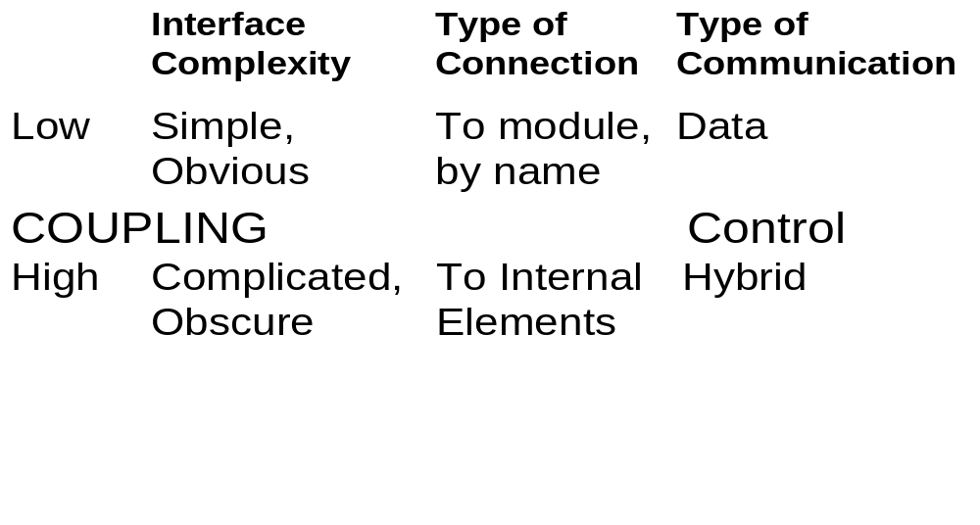

Strength of Single interaction coupling

Slide 7
Principles of interaction coupling
Principles from Modularization
  1: 《Global Variables Consider Harmful》
  2: 《To be Explicit》
  3: 《Do not Repeat》
  4: Programming to Interface

Slide 8
Main Contents
Coupling of OO
  Interaction Coupling
  Component Coupling
  Inherit Coupling
  Coupling Metric of OO
Cohesion of OO

Slide 9
Component coupling
Abstraction
  Define one place, using many place
  Class-Level , Object-Level
Component coupling
  The component relationship between classes is defined by the use of a class as domain of some instance variable of another class
  Not including Inheritance
  Usually Class-Level needed
    Attribute Type: how to explicit

Slide 10
Four Kinds of Component coupling
Whole variable: Aggregation
Parameter: Method Parameter
Creator: Creator in some method’s local
Hidden: Given by another object

Slide 11
Hidden Component coupling
The worst coupling: Implicit
The coupling between two classes C and C’ is rated hidden if C’ shows up neither in the specification nor in the implementation of C although an object of C’ is used in the implementation of a method of C
A similar problem is encountered if the return value of a method invocation is immediately used as input parameter in another method invocation
disallow the use of cascading messages
  To be explicit!

Slide 12
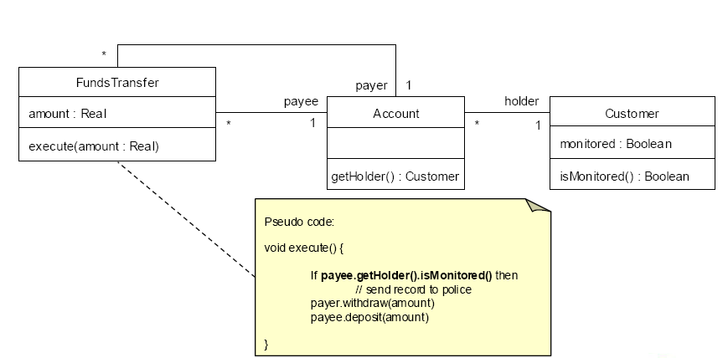
Hidden Component coupling

Slide 13
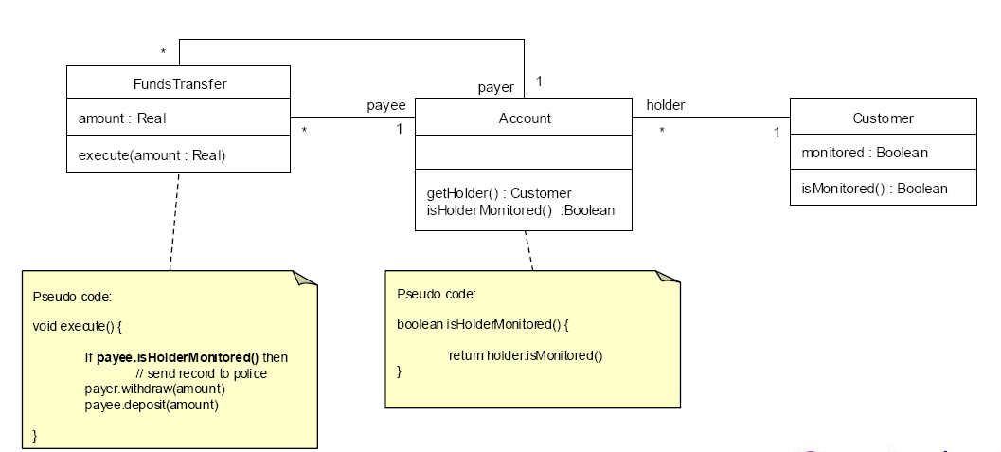
The Law of Demeter Example

Slide 14
Principles of Component Coupling
Principle 5: The Law of Demeter
  You can play with yourself.
  You can play with your own toys, but you can't take them apart
  You can play with toys that were given to you.
  You can play with toys you've made yourself.

Slide 15
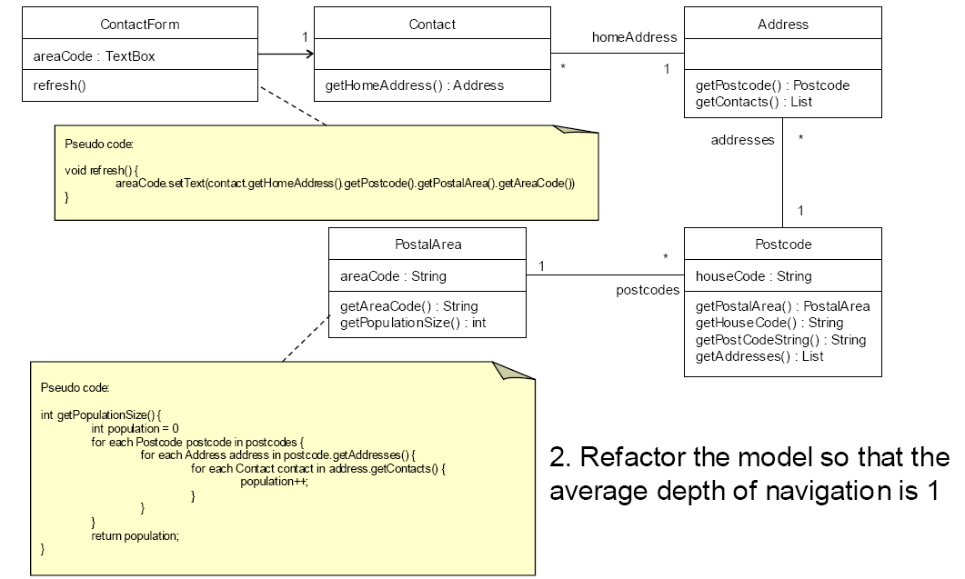


Slide 16
Scattered Component Coupling
We rate two classes C and C’ as scattered coupled if C’ is used as domain in the definition of some local variable or instance variable in the implementation of C yet C’ is not included in the specification of C
Common and acceptable
Aggregation: Global
Local instance: Local
Which is better?
  Many Connections VS Stronger Single Connection

Slide 17
Specified Component Coupling
We rate two classes C and C’ as specified coupled if C’ is included in the specification of C whenever it is a component of C
  Get Specified, Design by Contract——Suffered Interface VS Required Interface
  Suffered Interface: Specified
  Required Interface: Used
Scattered Component Coupling can be improved to Specified component coupling with comments

Slide 18
Principles of Component Coupling
Principle 4: Programming to Interface
    Programming to Required Interface, not only Suffered Interface
    Design by Contract
      Contract of Module/ Class
        Required mothods / Provided methods
      Contract of Methods
        PreCondition, PostCondition, Invariant

Slide 19
Principles of Component Coupling
Clients should not be forced to depend
upon interfaces that they do not use.
R. Martin, 1996
Principles 6: Interface Segregation Principle(ISP)
  Programming to Simpler Interface
Many client-specific interfaces are better than one general purpose interface

Slide 20
Principles of Component Coupling
—— ISP Explained
Multipurpose classes
  Methods fall in different groups
  Not all users use all methods
Can lead to unwanted dependencies
  Clients using one aspect of a class also depend indirectly on the dependencies of the other aspects
ISP helps to solve the problem
  Use several client-specific interfaces

Slide 21
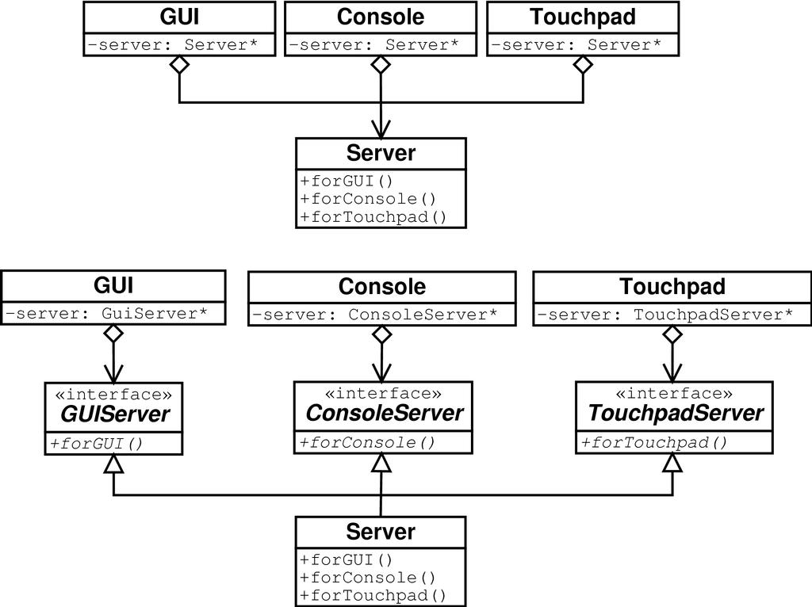
Principles of Component Coupling
—— ISP Example: UIs
The Server "collects" interfaces
New UI → Server interface changes
All other UIs recompile
UIs are isolated from each other
Can add a UI with changes in
Server → other UIs not affected

Slide 22
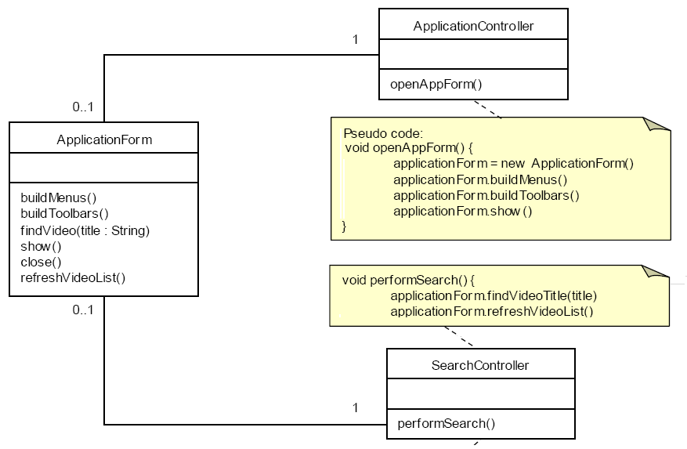

Slide 23
Main Contents
Coupling of OO
  Interaction Coupling
  Component Coupling
  Inherit Coupling
  Coupling Metric of OO
Cohesion of OO

Slide 24
Inheritance Coupling
Parent information is specified for children
With a parent reference, how many information a client needed when interacting?
  Modification
  Refinement
  Extension

Slide 25
Modification Inheritance Coupling
Modifying without any rules and restricts
Worst Inheritance Coupling
If a client using a parent ref, the parent and child method are all needed
  Implicit
  There are two connections, more complex
Harm to polymorphism

Slide 26
Refinement Inheritance Coupling
defining new information the inherited information is only changed due to predefined rules
If a client using a parent ref, the whole parent and refinement of child are needed
  1+connections
Necessary!

Slide 27
Extension Inheritance Coupling
the subclass only adds methods and instance variables but neither modifies nor refines any of the inherited ones
If a client using a parent ref, only the parent is needed
  1 connection

Slide 28
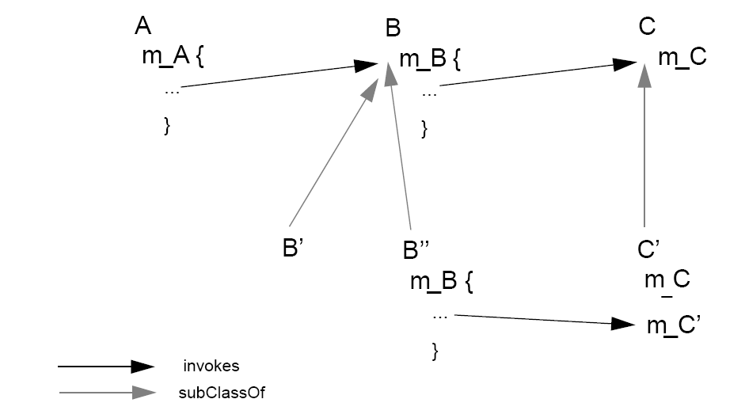
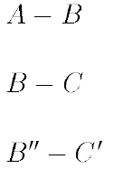
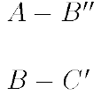

How Inheritance reduce coupling ?
Remember: in Refinement and Extension inheritance coupling, the interaction coupling between super-class and subclass is ignored

Slide 29
Principles of Inherit Coupling
Principle 7: Liskov Substitution Principle (LSP)
All derived classes must be substituteable
for their base class
Barbara Liskov, 1988
Functions that use pointers or references to base classes must be able to use objects of derived classes without knowing it.
        R. Martin, 1996

Slide 30
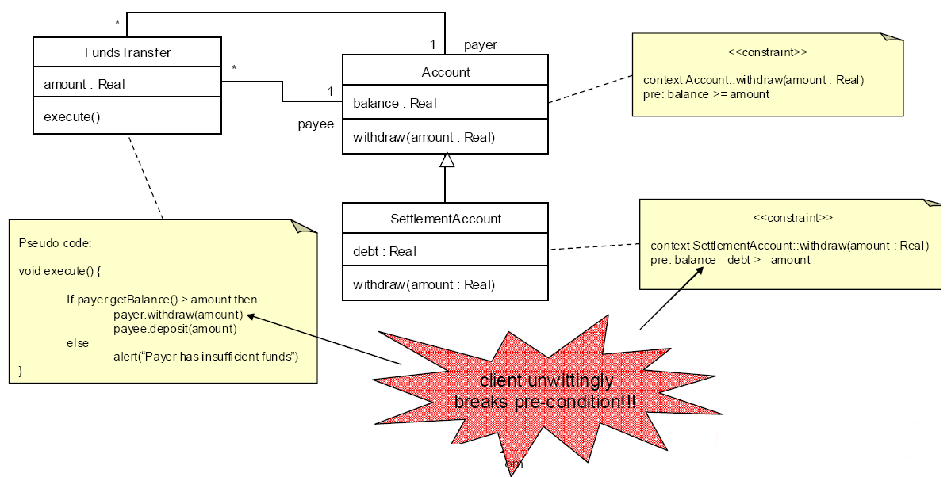
LSP: example

Slide 31
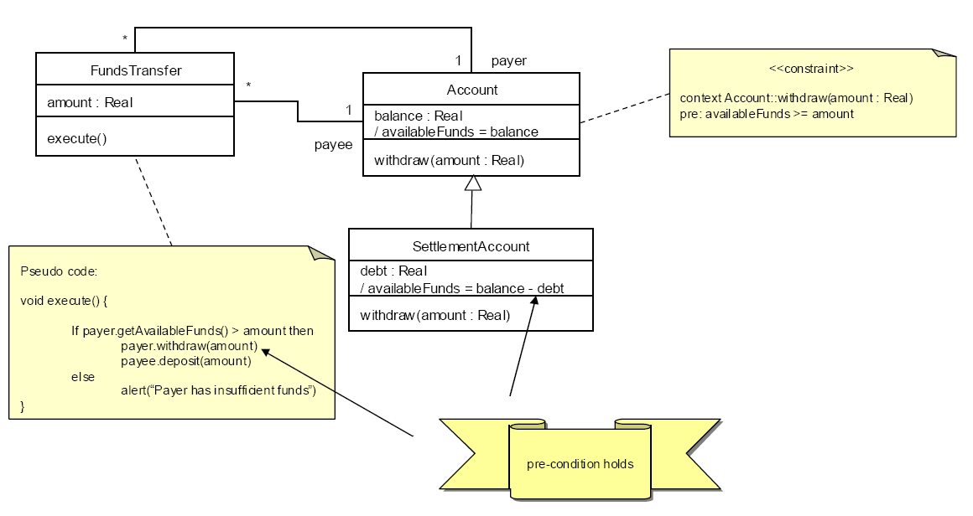
LSP: example

Slide 32
Inheritance Appears Simple
Is a Square a Rectangle?
Rect r = new Rect();
setWidth = 4;
setHeight=5;
assert(20 == getArea());
class Square extends Rect{
// Square invariant, height = width
setWidth(x) {setHeight()=x}
setHeight(x) {setWidth(x)}
} // violate LSP?

Slide 33
Inheritance Appears Simple
class Bird { // has beak, wings,...
public: virtual void fly(); // Bird can fly
};
class Parrot : public Bird { // Parrot is a bird
public: virtual void mimic(); // Can Repeat words...
};
class Penguin : public Bird {
public: void fly() {
error (“Penguins don’t fly!”); }
};

Slide 34

Penguins Fail to Fly!
void PlayWithBird (Bird& abird) {
abird.fly(); // OK if Parrot.
// if bird happens to be Penguin...OOOPS!!
}
Does not model: “Penguins can’t fly”
It models “Penguins may fly, but if they try it is error”
Run-time error if attempt to fly → not desirable
Think about Substitutability - Fails LSP

Slide 35
LSP Summary
LSP is about Semantics and Replacement
  Understand before you design
    The meaning and purpose of every method and class must be clearly documented
    Lack of user understanding will induce de facto violations of LSP
  Replaceability is crucial
    Whenever any class is referenced by any code in any system,
    any future or existing subclasses of that class must be 100% replaceable

Slide 36
LSP Summary
Design by Contract
  Advertised Behavior of an object:
    advertised Requirements (Preconditions)
    advertised Promises (Postconditions)
When redefining a method in a derivate class, you may only replace its precondition by a weaker one, and its postcondition by a stronger one
        B. Meyer, 1988
Derived class services should require no more and promise no less

Slide 37
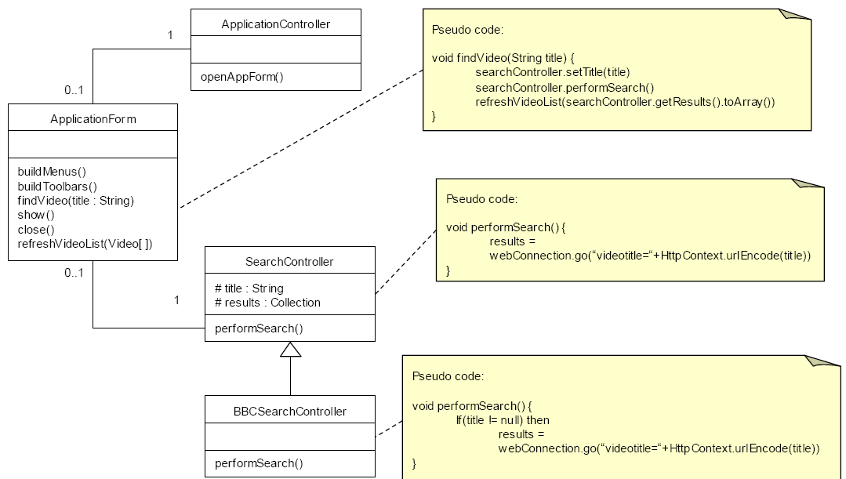

Slide 38
Principle 8 : Favor Composition Over Inheritance
Use inherit for polymorphism
Use delegate not inherit to reuse code!

Slide 39
Coad's Rules of Using Inheritance
Use inheritance only when all of the following criteria are satisfied:
  A subclass expresses "is a special kind of" and not "is a role played by a"
  An instance of a subclass never needs to become an object of another class
  A subclass extends, rather than overrides or nullifies, the responsibilities of its superclass
  A subclass does not extend the capabilities of what is merely an utility class

Slide 40
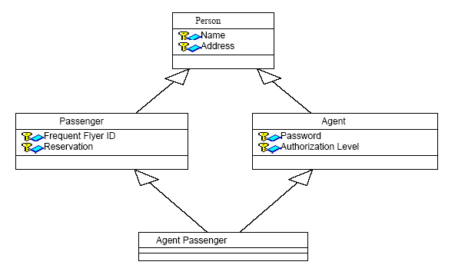
Inheritance/Composition Example 1

Slide 41
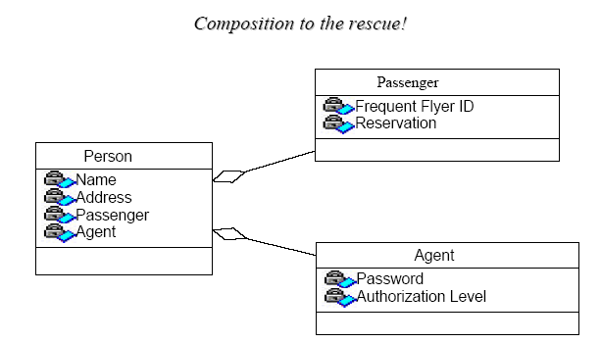
Inheritance/Composition Example 1 (Continued)

Slide 42
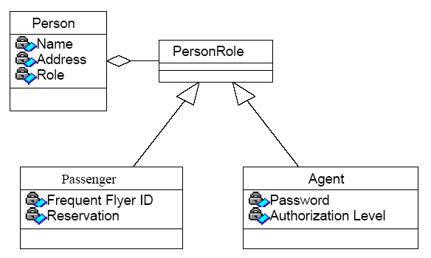
Inheritance/Composition Example 2

Slide 43
class Object {
public: virtual void update() {};
        virtual void draw() {};
        virtual void collide(Object objects[]) {};
        };
class Visible : public Object {
  public: virtual void draw() {
  /* draw model at position of this object */ };
  private: Model* model;
  };
class Solid : public Object {
  public: virtual void collide(Object objects[]) {
  /* check and react to collisions with objects */ };
};
class Movable : public Object {
public: virtual void update() {
/* update position */ };
};

Slide 44
Main Contents
Coupling of OO
  Interaction Coupling
  Component Coupling
  Inherit Coupling
  Coupling Metric of OO
Cohesion of OO

Slide 45
Coupling Metrics between classes
Coupling between object classes (CBO)
A count of the number of other classes:
  which access a method or variable in this class, or
  contain a method or variable accessed by this class
  Not including Inheritance
Want to keep this low

Slide 46
Coupling Metrics between classes
Data abstraction coupling (DAC)
The number of attribute having an ADT type dependent on the definitions of other classes
Want to keep this low

Slide 47
Coupling Metrics between classes
Ce and &D (efferent and afferent coupling)
  Ca: The number of classes outside this category that depend upon classes within this category.
  Ce: The number of classes inside this category that depend upon classes outside this category
Want to keep these low

Slide 48
Coupling Metrics between classes
Depth of the Inheritance tree (DIT)
  the maximum length from the node to the root of the tree
  as DIT grows, it becomes difficult to predict behavior of a class because of the high degree of inheritance
  Positively, large DIT values imply that many methods may be reused

Slide 49
Coupling Metrics between classes
Number of children (NOC)
  count of the subclasses immediately subordinate to a class
  as NOC grows, reuse increases
  as NOC grows, abstraction can become diluted
  increase in NOC means the amount of testing will increase

Slide 50
Main Contents
Coupling of OO
  Interaction Coupling
  Component Coupling
  Inherit Coupling
  Coupling Metric of OO
Cohesion of OO

Slide 51
Cohesion of Attributes
Separable
  represent multiple unrelated data abstractions combined in one object
multifaceted
  represent multiple related data abstractions
Non-delegated
  Some attribute represent a part of another class: not in third normal form
Concealed
  some attribute and referencing methods which may be regarded as a class of its own
Model: informational strength
  the class represents a single semantically meaningful conceptual

Slide 52
Cohesion of methods
Methods of a Class are Common coupling
All methods serve One Responsibility
  Informational Cohesion
  Relative functions (functional Cohesion)
  Principle 9: Single Responsibility Principle

Slide 53
Single Responsibility Principle (SRP)
A class should have only one reason to change
Robert Martin
Related to and derived from cohesion, i.e. that elements
in a module should be closely related in their function
Responsibility of a class to perform a certain function
is also a reason for the class to change

Slide 54
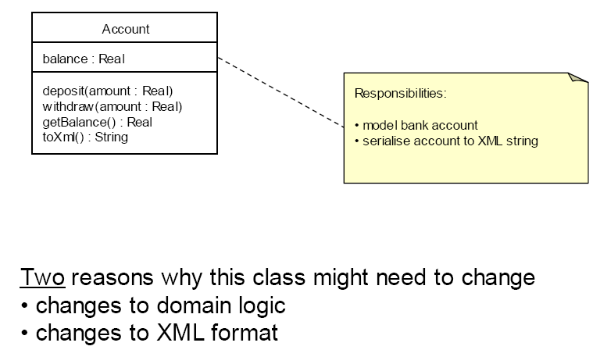
SRP Example

Slide 55
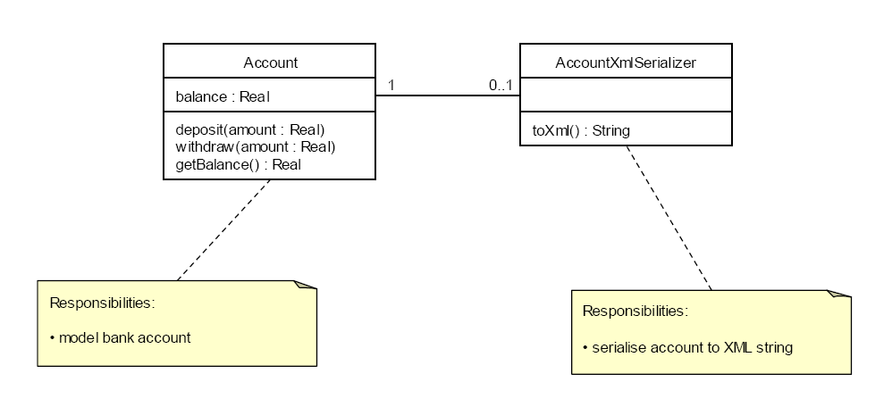
SRP Example

Slide 56
SRP Summary
Class should have only one reason to change
  Cohesion of its functions/responsibilities
Several responsibilities
  mean several reasons for changes → more frequent changes
Sounds simple enough
  Not so easy in real life
  Tradeoffs with complexity, repetition, opacity

Slide 57
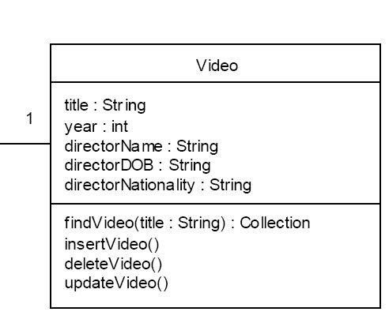
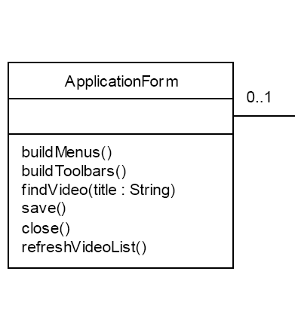

Slide 58
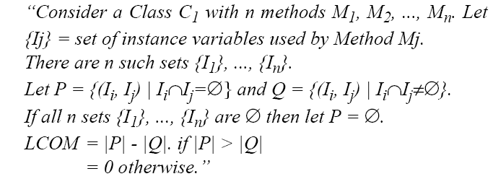
Measure class cohesion
Lack of cohesion in methods (LCOM)
Want to keep this low
Many other versions of LCOM have been defined

Slide 59
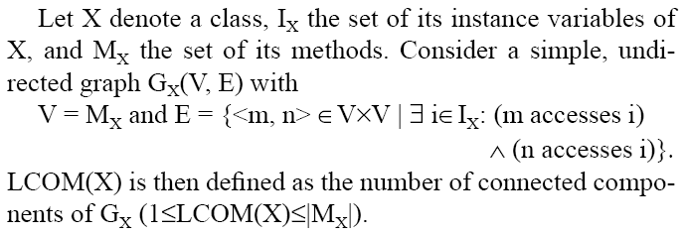
Measure class cohesion
If LCOM >=1, then the class should be separated

Slide 60
Principles of interaction coupling
Principles from Modularization
  1: 《Global Variables Consider Harmful》
  2: 《To be Explicit》
  3: 《Do not Repeat》
  4: Programming to Interface

Slide 61
More Principles
4: Programming to Interface (Design by Contract)
5: The Law of Demeter
6: Interface Segregation Principle(ISP)
7: Liskov Substitution Principle (LSP)
8: Favor Composition Over Inheritance
9: Single Responsibility Principle

